Slide 1
Threading and you: A ros 2 Primer
Jacob Friedberg
1

Slide 2

Outline:
Basics of Threading
When and Why to use them, Creating threads, Hazards.
Access control
Critical Sections, Semaphores, Locks, Mutex
Executors
Thread pools, rclpy.spin, Single Threaded, Multithreaded
Futures
Waiting for results, properties
Callback groups
Mutually exclusive, Reentrant, Parallel
Scheduling in ros2
Goal Status
New Skeleton
2

Slide 3
The basics of threading

Slide 4
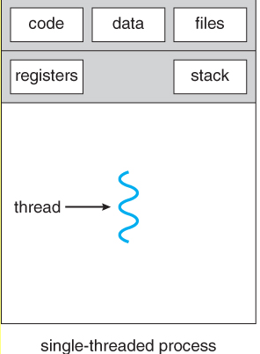
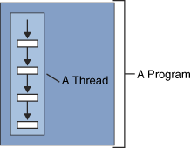
Basics of Threading
What is a thread(single threaded)?
A flow of execution
Probably most of your programs you have written are single threaded
Main()
A thread has its own resources allocated
Call Stack, variables, Scope
Runs on a core of the CPU
Hyperthreading/Simultaneous Multithread
What Is a Thread? (iitk.ac.in)
Operating Systems: Threads (uic.edu)

Slide 5
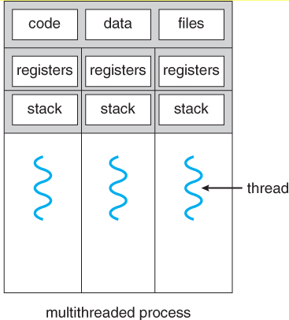
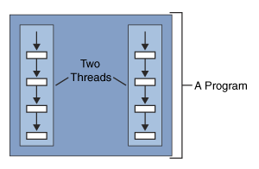
Basics of Threading
What is multi threading?
Multiple flows of execution running in your program
Each thread has its own resources allocated
Call Stack, variables, scope.
Shares common variables and constructs
Open files, Global variables,
Must share data to threads if you want it to have access.
Queues, messaging, global
What Is a Thread? (iitk.ac.in)
Operating Systems: Threads (uic.edu)

Slide 6
Basics of Threading
Why use threads?
Allows your programs to do more than one task at once.
Useful, for speeding up execution of parallelizable tasks
What is a parallelizable task?
A task that can be worked on independently, by multiple threads(workers)
Matrix multiplication, Array of calculations, Split up work into chunks that do not depend on one another.
When to use them?
When you don’t want to lock up your program doing work. Or want to do something in the background.
Servers processing requests, UI elements, Downloading files, Multiple applications windows, Rendering,

Slide 7
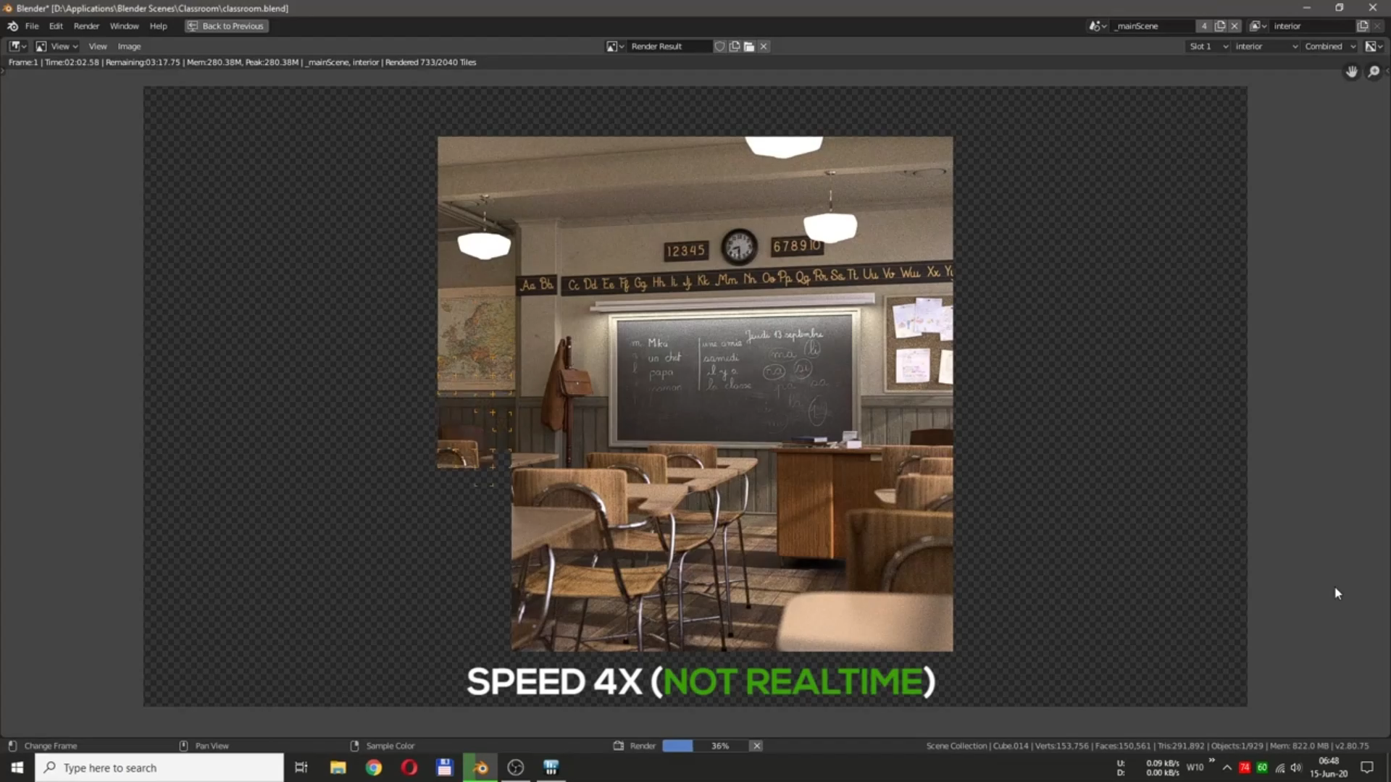
Basics of Threading

Slide 8
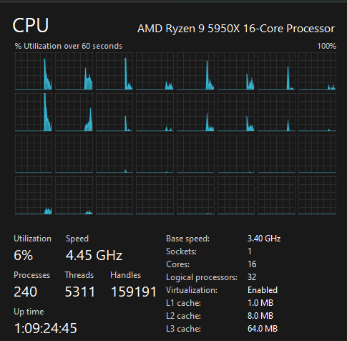
Basics of Threading
Threads are commonly used.
~5300 threads running on my computer with just a few applications open.
Most CPU’s have some form of Multi threading for their cores.
Can run 2 threads per core, at a slight performance cost.
How quickly a thread works depends on many factors
Scheduling, priority, cache, Temporal and spatial locality.

Slide 9
Basics of Threading
Creating Threads Python.
Excellent resource: An Intro to Threading in Python – Real Python
2 main types: Background, Foreground
Background end when the program ends
Foreground run until killed(can be problematic)
Threading Module: threading — Thread-based parallelism — Python 3.11.2 documentation
CODE EXAMPLE

Slide 10
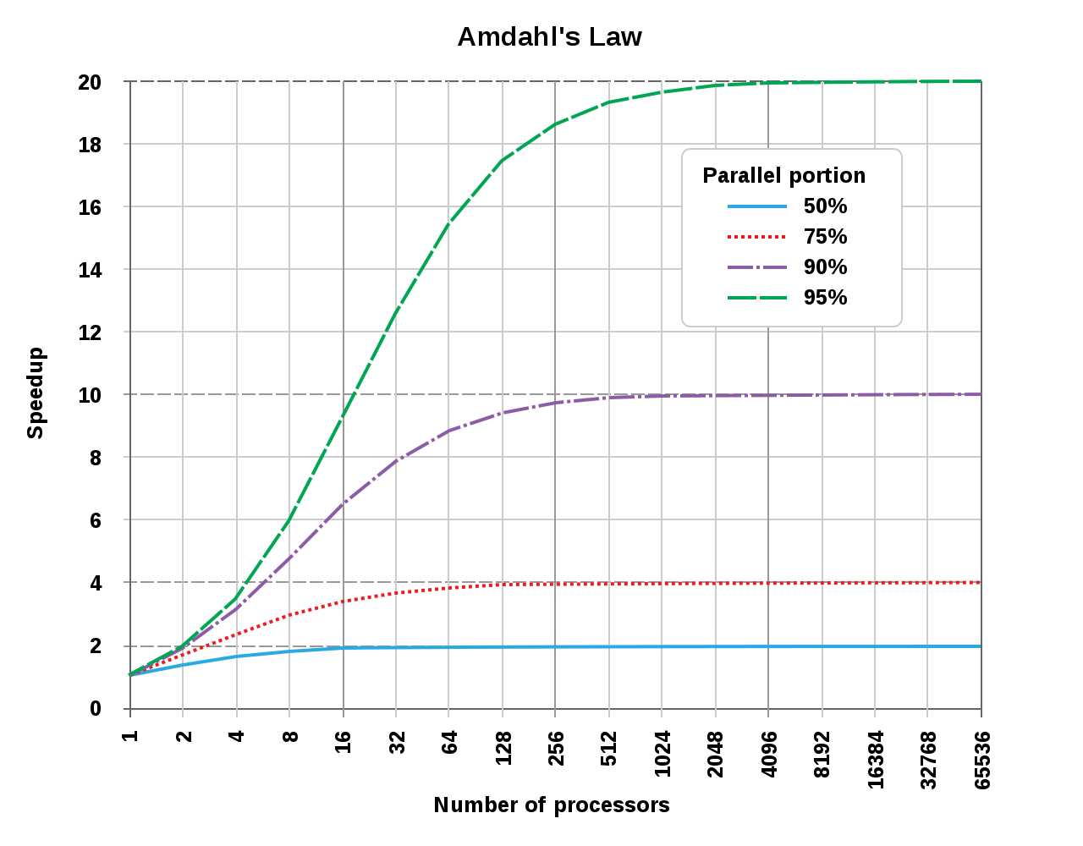
Basics of Threading
Note about parallelism
It is governed by Amdahls law
Speed up for threads is limited by parallelizable portion of the code. Serial will be the bottleneck
Amdahl's law - Wikipedia

Slide 11
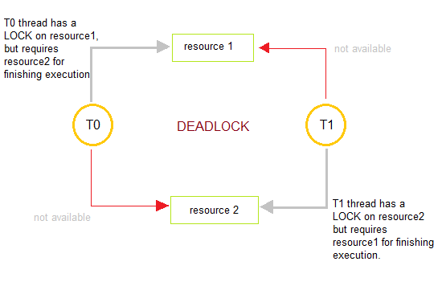
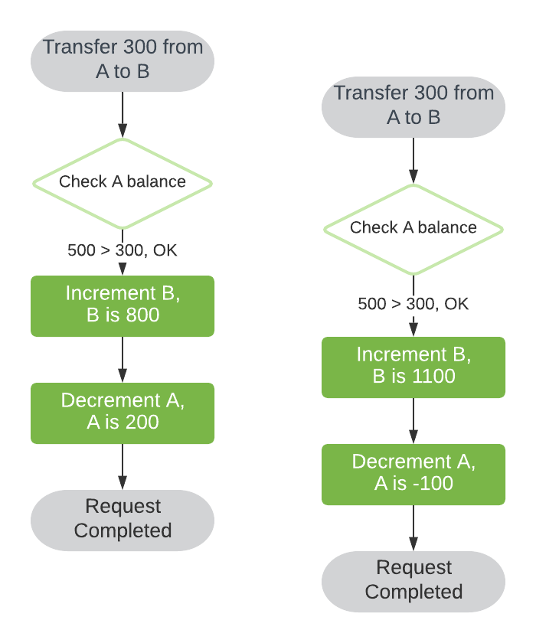
Basics of Threading
Hazards with threads.
Deadlock
Threads depend on resources that are not relinquished
Race Condition
Two threads access the same resource and want to change it. It is a race to see who writes last.
One thread writes data, and another thread reads during the write. Old value was read, but value is already changed.
Shared resources must be protected
Introduction to Deadlocks in Operating System | Studytonight

Slide 12
Access Control

Slide 13
Access Control
Shared resources must be protected. Due to various hazards.
Critical sections
areas of code that have potential hazards usually relating to thread unsafe resources. This area should only be accessed by one thread at a time.
Python provides a bunch of methods: Link
Locks
Mutex’s
Barriers
Semaphores

Slide 14
Access Control
Locks:
Only one thread can hold the lock. Mutual exclusion.
Acquire and Release
Blocking/Non-Blocking
Barriers
Synchronizes threads. Block until multiple threads are ready.
Thread number to wait, and timeout to block
Semaphores
Define max number of threads who can acquire this resource
Blocks if not available.
Acquire and release

Slide 15
Access Control
Code example

Slide 16
Executors

Slide 17
Executors
RCLPY has two types of executors
Single threaded
Multi threaded
What are executors?
High level objects that contain a callback list(work to do) and a thread pool. Plus, some other stuff that we don’t care about.
What is a thread pool?
A thread pool is a higher-level object that manages creation and lifetime of threads, and schedules work for them to do.

Slide 18
Executors
RCLPY Single Threaded Executor Executors — ROS 2 Documentation: Foxy documentation
A thread pool with a single thread.
This type of executor should never have its thread blocked.
RCLPY has internal function callbacks(action clients…) that need a thread to function correctly, and update values(Goal handles)
RCLPY.spin() creates this type of executor and calls spin on it.

Slide 19
Executors
RCLPY Multi Threaded Executor
A thread pool with a user defined number of threads.
This type of executor can have its threads blocked if you are careful about it.
Depends on how many threads were given to the executor. You ALWAYS need at least 1 thread free to perform internal callbacks.
If you do block, there is still a chance of deadlock. Your milage may vary.
executor.spin(node) initiates work. This will still consume the main_thread, but you can put it on its own thread to manage.

Slide 20
Futures

Slide 21
Futures
What is a Future object? Futures — Python 3.11.2 documentation
Async functions are functions that do not block and may have a long run processes to return a result.(IO, networking, user defined).
Async functions provide a future value, which is an object that indicates that the result of that function is ready.
This is to allow you to do other things while you wait (non blocking)
Future.done()
Returns true when your future result is ready to be assigned.
Future.Result()
Returns the result of the future which is of a type specified by the async function.
Future.add_done_callback()
Gets called when the future is done()

Slide 22
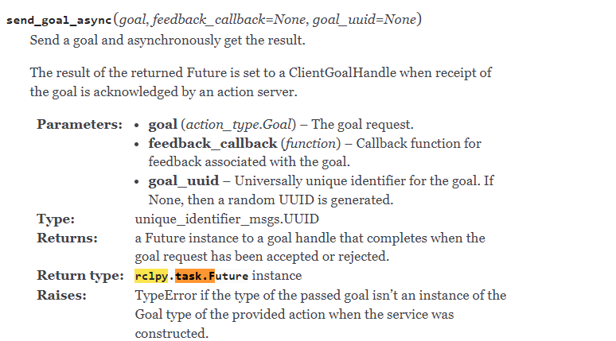
Futures
Notes about RCLPY futures
These are rclpy specific and implement most of the functionality of python futures. Some things are the same, others are slightly different.
Read the source code for rclpy if something is not working as described in the python documentation.

Slide 23
Callback groups

Slide 24
Callback groups
What is a callback group? Using Callback Groups — ROS 2 Documentation: Foxy documentation
A way to control the scheduling of the callback functions for executors in RCLPY
2 types
Reentrant
“Allows the executor to schedule and execute the group’s callbacks in any way the it sees fit, without restrictions. This means that, in addition to different callbacks being run parallel to each other, different instances of the same callback may also be executed concurrently”
Mutually exclusive
“Mutually Exclusive Callback Group prevents its callbacks from being executed in parallel - essentially making it as if the callbacks in the group were executed by a SingleThreadedExecutor”

Slide 25
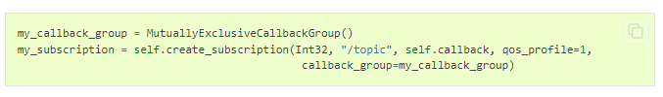
Callback groups
What is a callback group? Using Callback Groups — ROS 2 Documentation: Foxy documentation
Notes about the groups
“Callbacks belonging to different callback groups (of any type) can always be executed parallel to each other”
“It is also important to keep in mind that different ROS 2 entities relay their callback group to all callbacks they spawn. For example, if one assigns a callback group to an action client, all callbacks created by the client will be assigned to that callback group”

Slide 26
Scheduling in ROs2

Slide 27
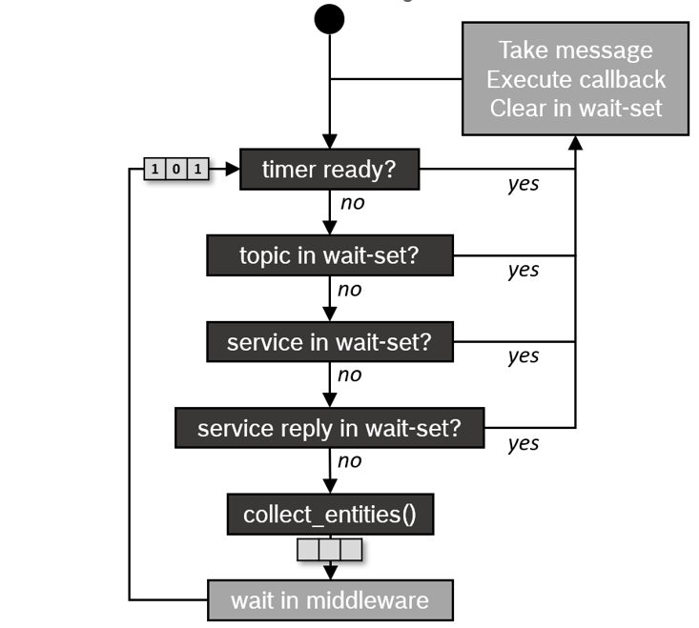
Scheduling in Ros2
What is scheduling? https://docs.ros.org/en/foxy/Concepts/About-Executors.html
Scheduling is the order in which our callbacks are executed.
In ROS2, if your callbacks are short and are “shorter than the period in which messages and events occur” in ROS2, then they will likely be executed in FIFO(first in first out) order.
Long running callbacks will cause a backup in messeges/events and will be executed in a round robin fashion as defined on the right.

Slide 28
Scheduling in Ros2
Why does it matter? Executors — ROS 2 Documentation: Foxy documentation
Callbacks may suffer priority inversion
Higher priority tasks are blocked until low priority callbacks finish
No explicit control over callback execution order
No built-in control over triggering for specific topics.
ROS2 is considered a distributed(due to the nodes) RTOS but has challenges meeting hard real time requirements.
Hard real time: Events/actions must happen right now! Ex: Pull the fuel rods out of the reactor.

Slide 29
Goal Status

Slide 30
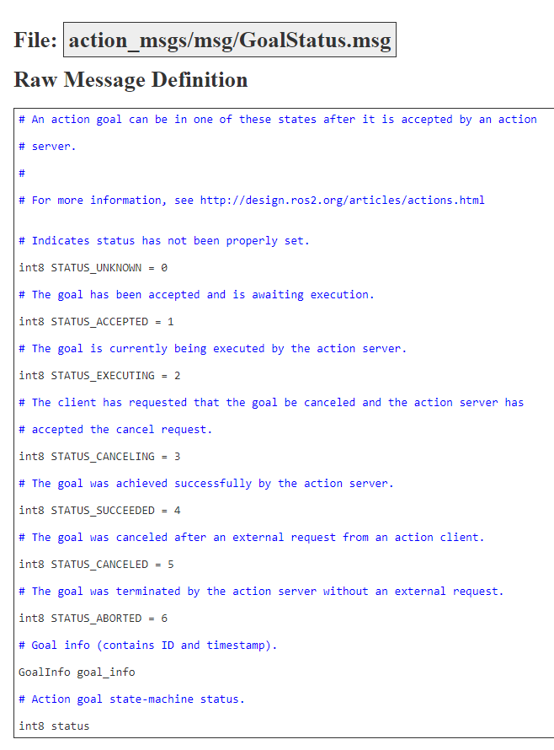
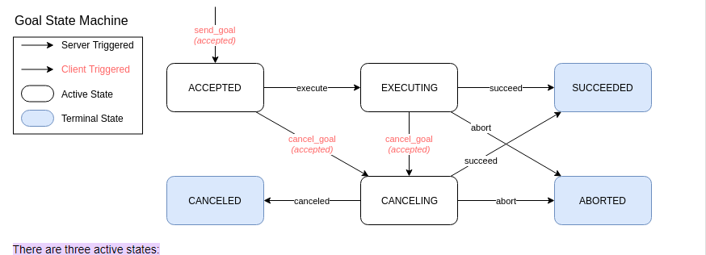
Scheduling in Ros2
Goal Status defines the current state of a goal. Actions (ros2.org)
This value is stored in the goal handle as GoalHandle.Status
Use these statuses to determine the state of the goal

Slide 31
New Skeleton

